Slide 1


Analyse International Debt Statistics
DETAILED PROJECT REPORT
Syed Ameer John SK
iNeuron

Slide 2





PROJECT DETAILS
Project Title | Analyze International Debt Statistics
Technology | Business Intelligence
Domain | Dept
Project Difficulty level | Advanced
Programming Language Used | Python
Tools Used | Jupyter Notebook, MS-Excel, Tableau
iNeuron

Slide 3
OBJECTIVE
Project Tasks
1. The World Bank's international debt data
2. Finding the number of distinct countries
3. Finding out the distinct debt indicators
4. Totaling the amount of debt owed by the countries
5. Country with the highest debt
6. Average amount of debt across indicators
7. The highest amount of principal repayments
8. The most common debt indicator
9. Other viable debt issues and conclusion
▶
iNeuron

Slide 4
PROBLEM STATEMENT
▶ It's not that we humans only take debts to manage our necessities. A country may also
take debt to manage its economy. For example, infrastructure spending is one costly
ingredient required for a country's citizens to lead comfortable lives. The World Bank is
the organization that provides debt to countries.
▶ In this project, you are going to analyze international debt data collected by The World
Bank. The dataset contains information about the amount of debt (in USD) owed by
developing countries across several categories.
iNeuron

Slide 5
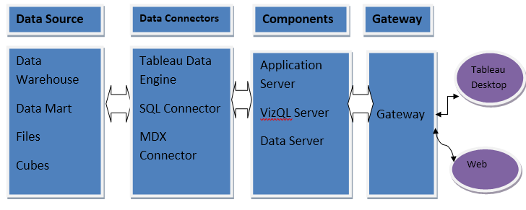

Slide 6
Dataset Information
The dataset consists of 73401 individual data. There are 14 columns in the dataset, which are described below.
Country Name - Display the Country Name.
Country Code- Display the Country code based on Country Name
Counterpart-Area Name - Displays the General as World
Counterpart-Area Code - Displays the Code for World
WLD- World
Indicator Name - Displays the Reason for Dept
Indicator Code – Displays The unique code for Different Indicator

Slide 7
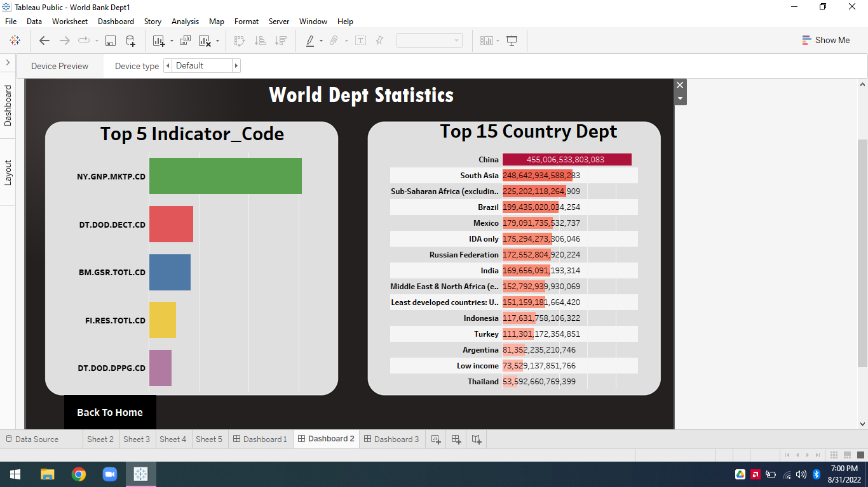

INSIGHTS
5 Common indicator for Major Dept?

Slide 8
Who suffers from Dept ?

Slide 9
Other Observations:
Total 1st Country with high Dept is China
All Country Have Same 129 Dept Indicators
This Indicator DT.AMT.DLXF.CD Having highest amount of principal repayments
128 Unique Country’s present in the Dept Analysis
569 Distinct Indicators and Indicator Name for Dept
China Dept is 13.102% Over all World Country’s

Slide 10
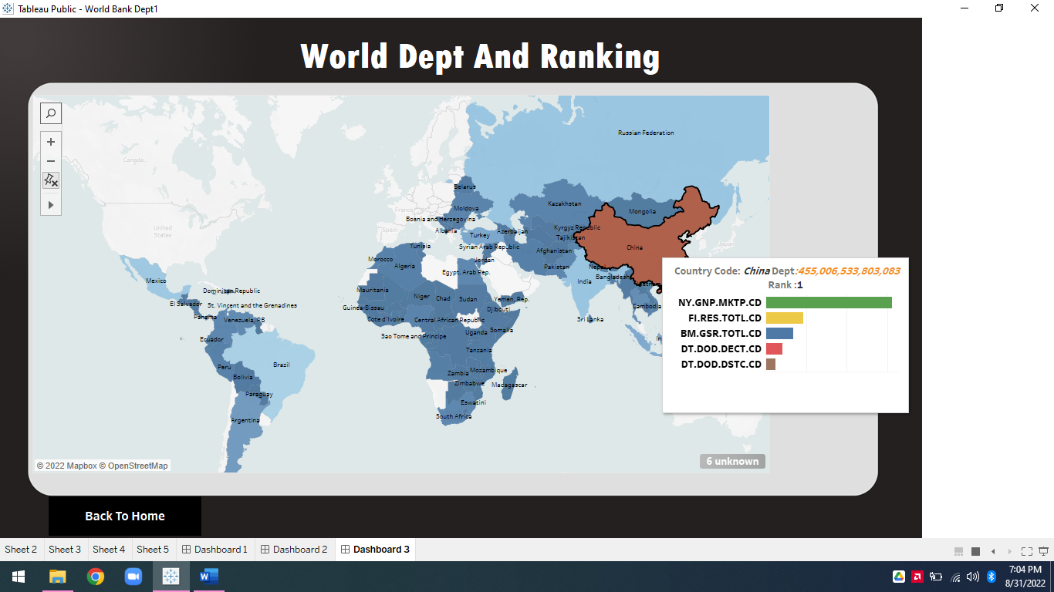

Slide 11
KEY PERFORMANCE INDICATOR (KPI)
Key indicators displaying a summary of the Investment Analysis and its relationship with different metrics
Country wise Dept, Total no of Dept Country
Which Indicator has maximum or minimum indicator. Total Sum of dept Country Wise.
Indicator wise analysis like Country’s Common Indicators

Slide 12


Slide 13
THANK YOU!

